Slide 1
Introduction to Backend 🤖
Introduction to backend web development, including client-server architecture and the role of the backend (Day 1)
Notes:
Photo by Mark König on Unsplash

Slide 2
Lesson Outcome
By the end of today, you should be able to:
Understand the basics of backend web development
Describe the client-server architecture and the role of the backend
Explain what Node.js is and its advantages
Install Node.js and set up the development environment
Use NPM to manage packages in a Node.js project

Slide 3
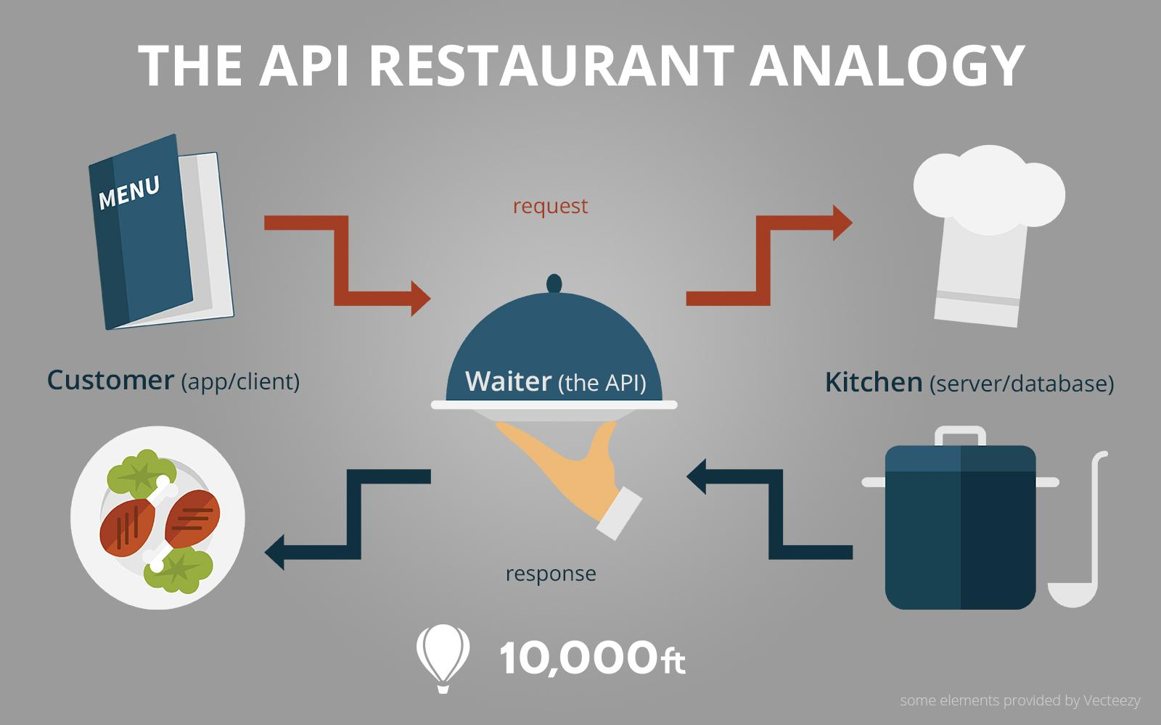
Introduction to Backend: Restaurant
Think of a restaurant. In this analogy, the frontend is the dining room where clients interact with the menu and make their orders, whilst the backend is the kitchen where the actual food preparation happens.
The "order" a customer places is comparable to a user request made from the frontend. This request is received by the backend, which processes it and sends the necessary data (the "meal") back to the frontend for the user to see.

Slide 4
Introduction to Backend: Restaurant
In summary, the backend plays a crucial role in ensuring that the web application functions smoothly and efficiently, just like a well-run kitchen is essential for a successful restaurant experience.
This is a quite important concept so be sure to grasp this concept firmly before moving on. Any questions?

Slide 5
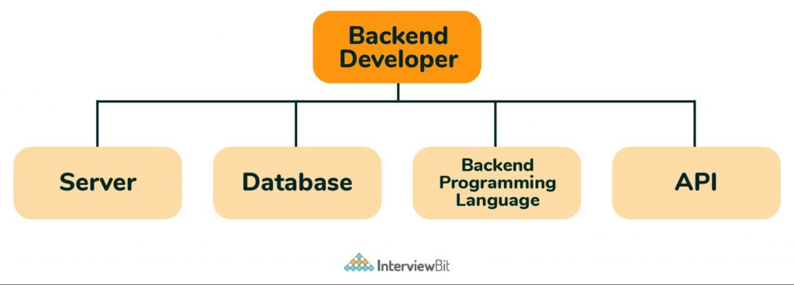
Roles of the backend

Slide 6
Processing User Input ✅
Handle forms, user actions, and validate input data.

Slide 7
Data Storage & Retrieval 📝
Manage databases, store and fetch data as needed

Slide 8
User Authentication & Authorization 🔐
Verify user identity and control access to resources.

Slide 9
Server-Side Rendering 🌐
Generate HTML pages dynamically before sending to the client.

Slide 10
API Development & Integration 🤖
Create and manage APIs for data exchange with other system.

Slide 11

Introduction to Node.js
JavaScript runtime: Allows developers to use JavaScript on the server-side
Event-driven, non-blocking I/O model: Enables high scalability and performance
Large ecosystem of packages: Provides a wide range of tools and libraries for building web applications.

Slide 12
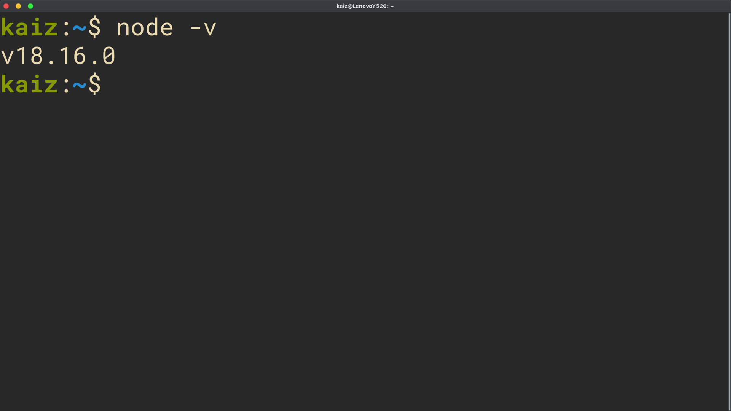
Installation and Setup
Download the Node.js installer from the official website.
Run the installer and follow the prompts to install Node.js.
Verify the installation by running node -v in the terminal.

Slide 13
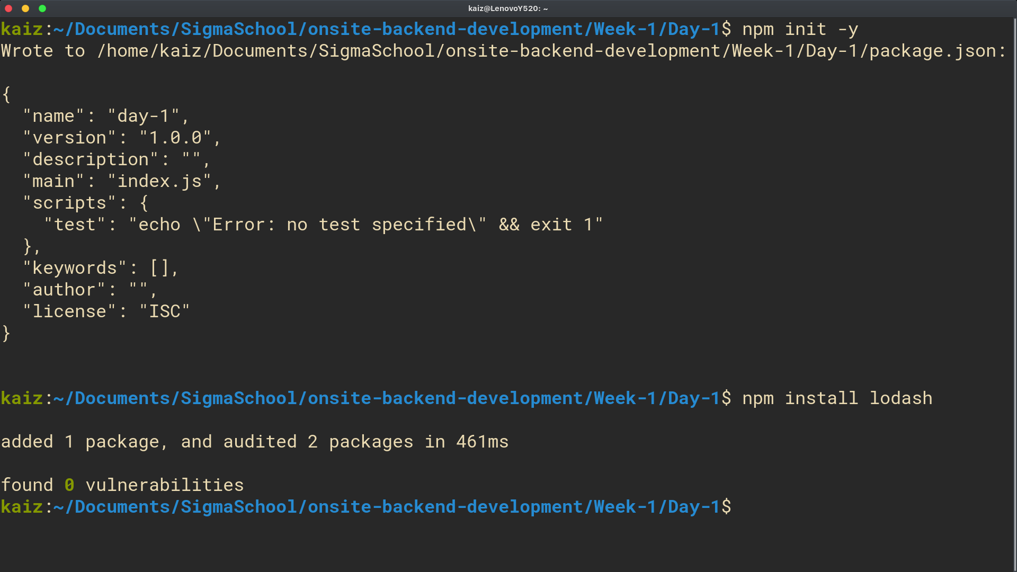
Using NPM to Manage Packages
Initialize a new Node.js project using npm init -y (Note: if you omit -y, it will ask you to confirm each step)
Install packages using npm install package-name
Save packages as dependencies using npm install package-name --save
Now, try it again but this time don’t use -y when initializing a new project.

Slide 14
Building a "Hello World" Server
Create a new folder on your local machine. Name it hello-world-server.
Open a terminal/cmd inside this new folder and initialize a new Node.js project using npm init -y
Create a new file called server.js
Import the http module and create a new server using http.createServer()
Listen for incoming requests using server.listen()
Print a message to the console when the server starts

Slide 15
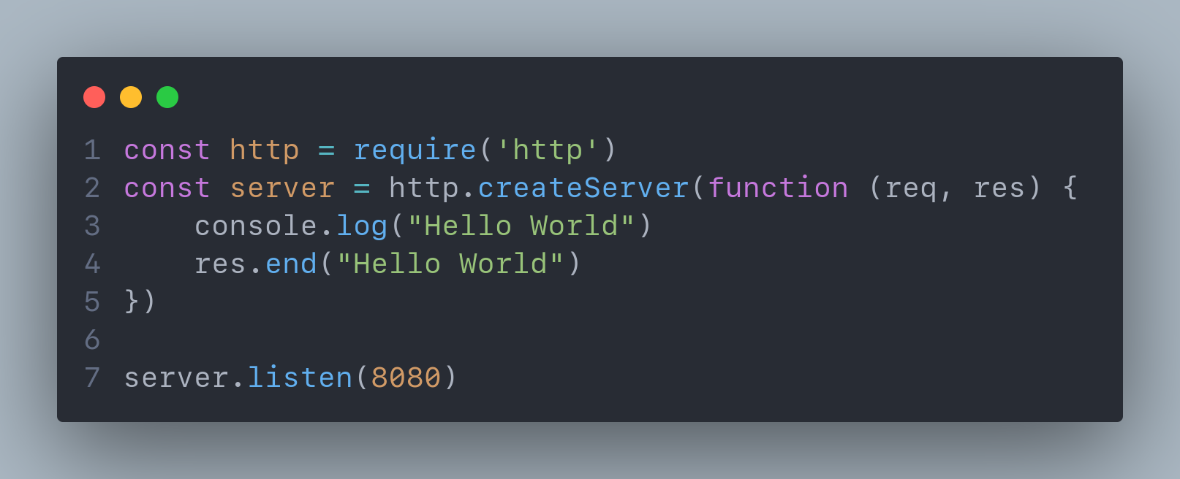
Building a "Hello World" Server

Slide 16
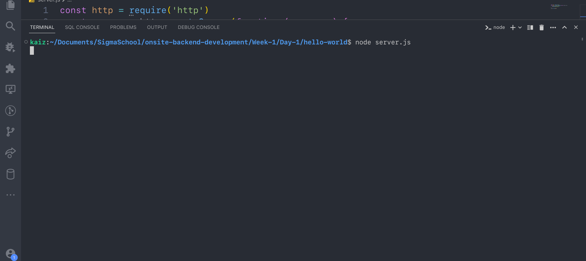
Let’s run the server…

Slide 17
Nothing’s happening? 🤔
That’s because the server has started but we aren’t receiving any requests yet. To receive requests, you need to send them. Our server is running on port 8080, open up your browser and go to http://localhost:8080.

Slide 18
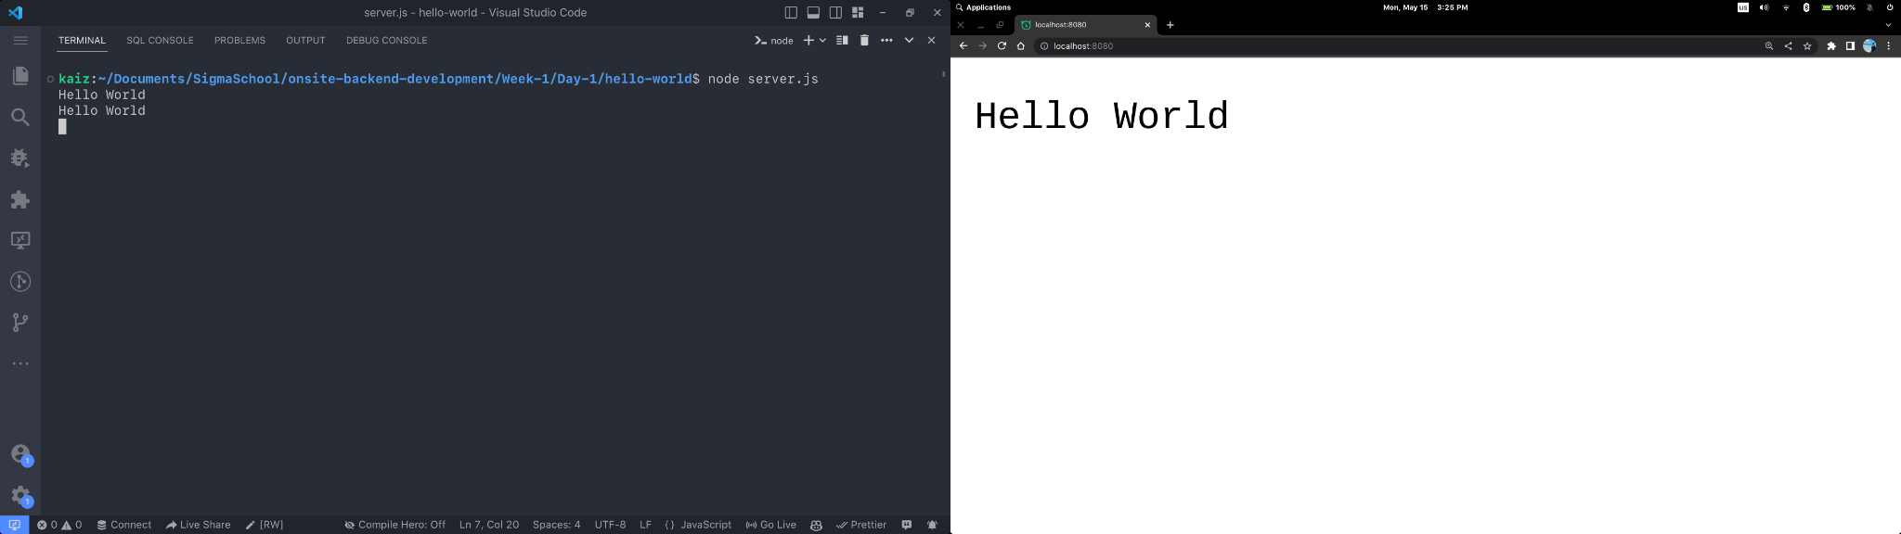
Voila! We can see the requests coming in!

Slide 19
Congrats! You just built your first server! Here’s to many stable servers 🥳

Slide 20
HTTP Server Basics of an HTTP Server
HTTP: Hypertext Transfer Protocol
Used for transmitting data over the internet
Consists of a request and a response
HTTP Server: A server that handles incoming HTTP requests and sends back HTTP responses
Can be used to serve web pages, APIs, and more

Slide 21
Self Cover: Intro to Node.js Up until .lock file assignment

Slide 22
Task of the day Build a server that generates random quotes using HTTP server.

Slide 23
Take home tasks

Slide 24
Some homework 📚
Code Along Project 3
Assignment 3
Capstone Project: Sorting Algo

Slide 25
References
Node HTTP Module
HTTP Status Codes
Anatomy of HTTP Request and Response

